Slide 1
Development of the Inclusion Strategy and Service
Primary Heads Consortia Update
September 21

Slide 2
Purpose
To share with PHC an update on development of the Inclusion Strategy
To share proposals with PHC on the new Inclusion Service
To share information with PHC on the new Footprint model and how services will be structured around them

Slide 3
Development of the inclusion agenda in Stockport – Timeline- Previous work
Autumn 2020 - A public consultation was undertaken on the initial DSG Review recommendations- we are now in the implementation phase
March to May 2021- Several stakeholder reference groups with headteachers met to work up the basis for the new services considering national best practice/current needs within Stockport.
There was also an internal working group of Inclusion Heads of Service which met to input into development of the new service offer.
June 21- SMBC Scrutiny received an update on the high-level proposals
July 21- A joint SENCO/Headteacher inclusion conference undertaken to look at collective definitions and measurements.​

Slide 4
Inclusion strategy and action Plan
The joint SENCO/Headteacher conference which took place in July which was very well attended and got good feedback. At the conference we co-produced the following three aims which will be at the heart of our educational inclusion strategy:
Equity - All children and young people in Stockport have the same opportunity to reach their potential and we will actively work to remove barriers to equity of opportunity
Belonging - All children and young people in Stockport have a sense of belonging within their own educational setting, within their community and within Stockport as a whole
Collaboration – In Stockport we will collaborate within settings, between settings and across the wider systems to achieve the best for our children and young people.
These aims will now be further worked up and will provide the basis of provision with the new inclusion service linking into the ETAS and the corporate agenda. The next inclusion event on the 21st of October will build on these principals in more detail.

Slide 5
Inclusion service- proposed delivery model
Service specification is being written up based on I Thrive quadrants
A universal offer which will be across all schools. An enhanced offer /resource will be weighted to footprints and laid out in service specification. Taking into account de-delegated monies
Proposed- Inclusion leads in each footprint to develop inclusion partnerships. They will coordinate the service offer and inclusion team with a key link to ETAS
The funding for the teams will be financed by DSG high needs block and primary schools de-delegated monies
Currently this is limited to existing SEND services with the opportunity to extend model to include other services.
Notes:
We could extend wider and this could positively impact on MTFP- autism team/school age plus etc could come under inclusion lead line management?

Slide 6
Key benefits for primary schools
Capacity building within individual schools, and access to specialisms based on level of need. Teams to have a focus within Footprint and be part of TAS
The universal new offer will be weighted to take into account different demographic factors.
The new offer will be tiered:
Minimum core offer will be funded for all schools and available to all schools- training/inclusion agenda
A targeted offer will be delivered based on the need in the footprints
A further top up also available for schools that want further support

Slide 7
Development of the inclusion agenda in Stockport – Timeline- Next steps
Sept 21- Focused work will be undertaken with task and finish group on the Behavior Support Service element of offer. The service specification and the future funding model will also be finalised.
Oct 21- The next inclusion event will test the worked-up inclusion principals with Head Teachers.
Nov/Dec 21- Take the new proposed service specification and structures through governance –
Jan 22 - Launch of the inclusion strategy and action plan which will be embedded within corporate inclusion agenda
Jan 22- Internal consultations on new service will start to allow time for new structure for Sept 22 start
March 22- Final structures taken through governance

Slide 8
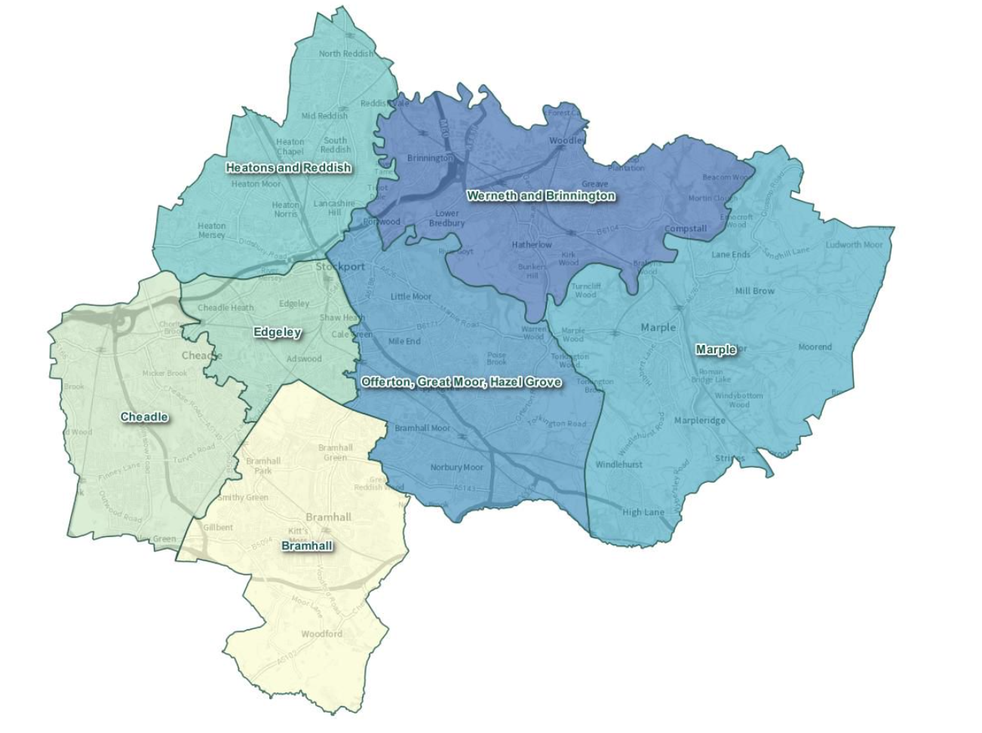
Footprints to deliver Children's Services
Notes:
Move services for children closer to where they and their families live, learn and play.
Establish footprints to enable children to receive services and support in the locations that make sense to them; providing better continuity of support and enabling us to use data to gain a better insight for a fuller picture of need and service provision in each locality.
Establish an effective team around all schools across Stockport, to enable the best support to families, who are often unclear who the right professional person or service is to ask advice and work with to support families and avoid escalation.
This is both a mindset and a model for integrating service delivery. The named multi-disciplinary team professionals works together through effective relationships to collectively problem solve, plan and deliver support to meet identified need.
Problem-solve together in real-time each day as needs emerge. Schools will have trusted working relationships with the professionals who are part of their team around the school
The core team will involve Social Workers, Early Help (SAP’s), School nursing, Education Welfare. Also include SEND and Education Support Services as well as other Stockport family teams YOS/MOSAIC/ASPIRE. There will be a wider team members that can join as needed including Housing, the Police and community and the voluntary sector.

Slide 9
How the footprints were determined
Population
Birth rates
Distribution of social housing
School leaver flows between primary and secondary school
The number of schools in each footprint
Environmental boundaries and factors

Slide 10
What the team size and composition in each footprint will be based on
SW referral data
Early Help data
Free School Meals data
SEND data
Attendance data
Academic outcomes data

Slide 11
Schools in each Footprint
 | Bramhall | Cheadle | Edgeley | Great Moor, Offerton, Hazel Grove | Heatons and Reddish | Marple | Werneth & Brinnington
Primary | Hursthead Inf Hursthead Jr Ladybrook Nevill Road Inf Nevill Road Jr Queensgate Thorn Grove Pownall Green Moss Hey Lane End | Bolshaw Cheadle Hulme Cheadle Etchells Gatley Prospect Vale Oak Tree Lum Head Outwood Bradshaw Cheadle Catholic Inf Cheadle Catholic Jr North Cheshire Jewish Meadowbank | Adswood Alexandra Park Bridge Hall Cale Green Cheadle Heath Ladybridge Larkhill Our Lady’s RC St Ambrose RC St Matthew’s CE | Banks Lane Inf Banks Lane Jr Dial Park Great Moor Inf Great Moor Jr Norbury Hall Torkington Vernon Park Warren Wood Hazel Grove St Thomas Catholic St Peter’s Catholic St Simon’s Catholic St George’s CE Moorfield | Broadstone Hall Mersey Vale Norris Bank Abingdon Tithe Barn Whitehill Didsbury Road All Saints (Stckp) St John’s CE St Mary’s CE St Elisabeth’s CE St Mary’s RC St Thomas CE HC St Winifred’s RC Vale View St Joseph’s Catholic | Brookside High Lane Ludworth Mellor Rose Hill All Saints (Marple) St Mary’s Catholic (Marple) | Arden Bredbury Green Bredury St Mark’s CE Greave Romiley St Bernadette’s RC St Christopher’s RC St Paul’s CE Westmorland Woodley
Secondary | Bramhall High Cheadle Hulme High St James’ Catholic | Laurus Cheadle Hulme The Kingsway School | Stockport Academy | Stockport School Hazel Grove High | Reddish Vale High Priestnall St Anne’s RC High | Marple Hall High | Harrytown RC High Werneth High
Special | Valley Primary |  | Oakgrove Pendlebury | Castle Hill High Lisburne Primary | Moat House Heaton School | Windlehurst | Highfields Secondary

Slide 12
Footprint model and Team Around the School
Ambition is for a fully functional and informed core team comprised of Stockport Family services, school staff and community assets
September is the start of process of developing those teams
Focus in the first term will be on ensuring our TAS processes work as well as they can, co-locating into the Footprints, developing strong relationships within the core teams – school personnel equal participants in this
Before October half term there will be a 7 Footprint Leadership meetings (one for each footprint) with Headteachers from the schools, Principal Leads, Service Leads, Locality Leads, Team Leads and Programme Lead. This will establish how we will work together and begin to understand the context, challenges and strengths of each area and also help us to ensure our resources are targeted where the support is needed. This is not a one-size-fits-all model.
This will be followed up by 7 Footprint Operational Meetings with school Pastoral Leads and SENDCos, Team Leaders, Senior Pracs, Programme Lead

Slide 13
When
Exploration, relationship building, standardising TAS |  |  |  | Widening the core team |  |  |  |  | Embedding/refining footprint working
Inductions |  |  |  | Joint Continued Professional Development Common vision, purpose, language
2021 |  |  |  | 2022
Sept | Oct | Nov | Dec | Jan | Feb | Mar | April | May |  | June | July | Aug | Sept
TAS Guide Circulated |  | TAS meetings to take place using the new guidance |  |  |  |  |  |  |  |  |  |  | Fully embedded programme in place
Introductory meetings with schools |  | Exploratory Meetings with individual schools |  |  |  | Building our resources around response to need
Conversations with boroughwide services |  |  |  | Codesign alignment of services to footprints
Conversations with Inclusion services based on DSG implementation |  |  |  | Codesign alignment of inclusion services to footprints
Updating the levels of need guidance |  | Update relevant processes |  | Implement new TAS and MASSH interface

Slide 14
Any questions?

